Slide 1
Machine Learning & Deep Learning
Getting Started Workshop
Dinesh Kumar Subramanian
Founder, DTeam

Slide 2
About Me
B-Tech IT
MS - HCI and Data Mining - U of I, Chicago
Founder DTeam
AI & Full-Stack
Twitter: @ortist
Apps: Wizhi, Ortist, Ship Mining, IPC Notes
Founder @ DreamApp, DreamCards, DreamStudio, DCrew

Slide 3
About DTeam
AI Company
JS, Python
Based in Chennai
Enlightenment

Slide 4


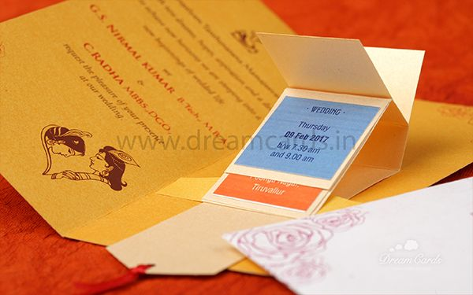

About Dreamcards
Indian Wedding Cards
Caricature Wedding Cards
Traditional Wedding Cards
Paper Engineering Cards
Website: www.dreamcards.in FB: www.fb.com/dreamcardsin

Slide 5
Agenda
Intro to jupyter Notebook
Introduction to python
Numpy Essentials
Data Visualization
Exploring data with pandas
Cleaning and preparing data
Introduction to ML
Introduction to Deep learning
Understanding perceptron
Decoding backpropagation
Deep learning with Tensorflow

Slide 7
Machine Learning
The art of finding patterns

Slide 8
Its All About
Data

Slide 9
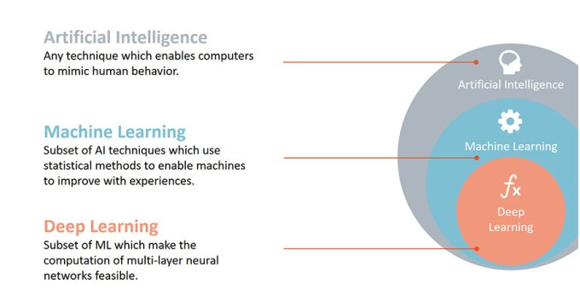

Slide 10
What is Machine Learning
The field of study that gives computers the ability to learn
without being explicitly programmed

Slide 11
1. Email Spam Detection
2. Face recognition
3. Speech recognition
4. Computer Vision and Image classification
5. Self-Driving cars/Driverless cars
6. Advertisements (Google Ad sense, sponsored ads)/Recommendations engines
7. Anti-virus
8. Healthcare (detecting disease on the early stages)
9. Weather forecast
Applications of Machine Learning

Slide 12


Slide 13
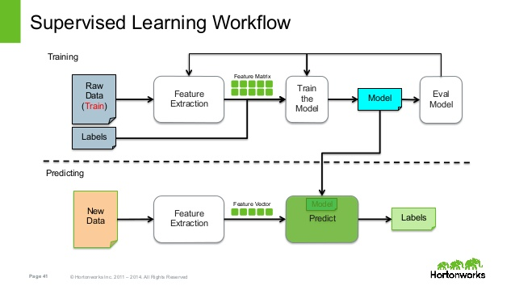

Slide 14
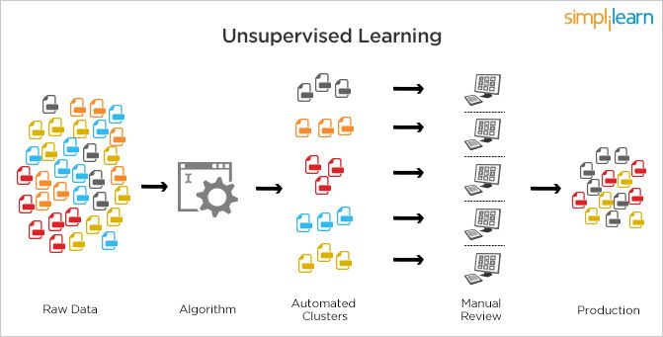

Slide 15
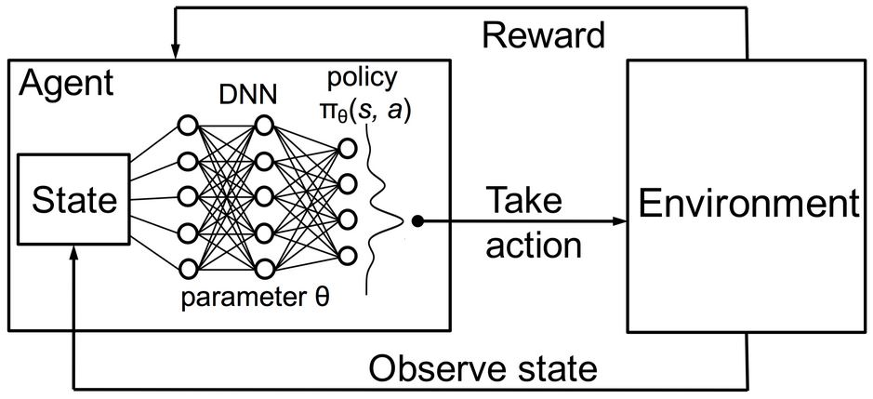
Reinforcement Learning

Slide 16
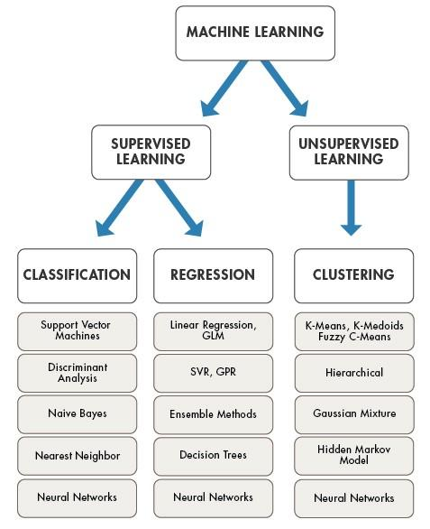

Slide 17
What is
Deep Learning/ Deep Neural Network

Slide 18
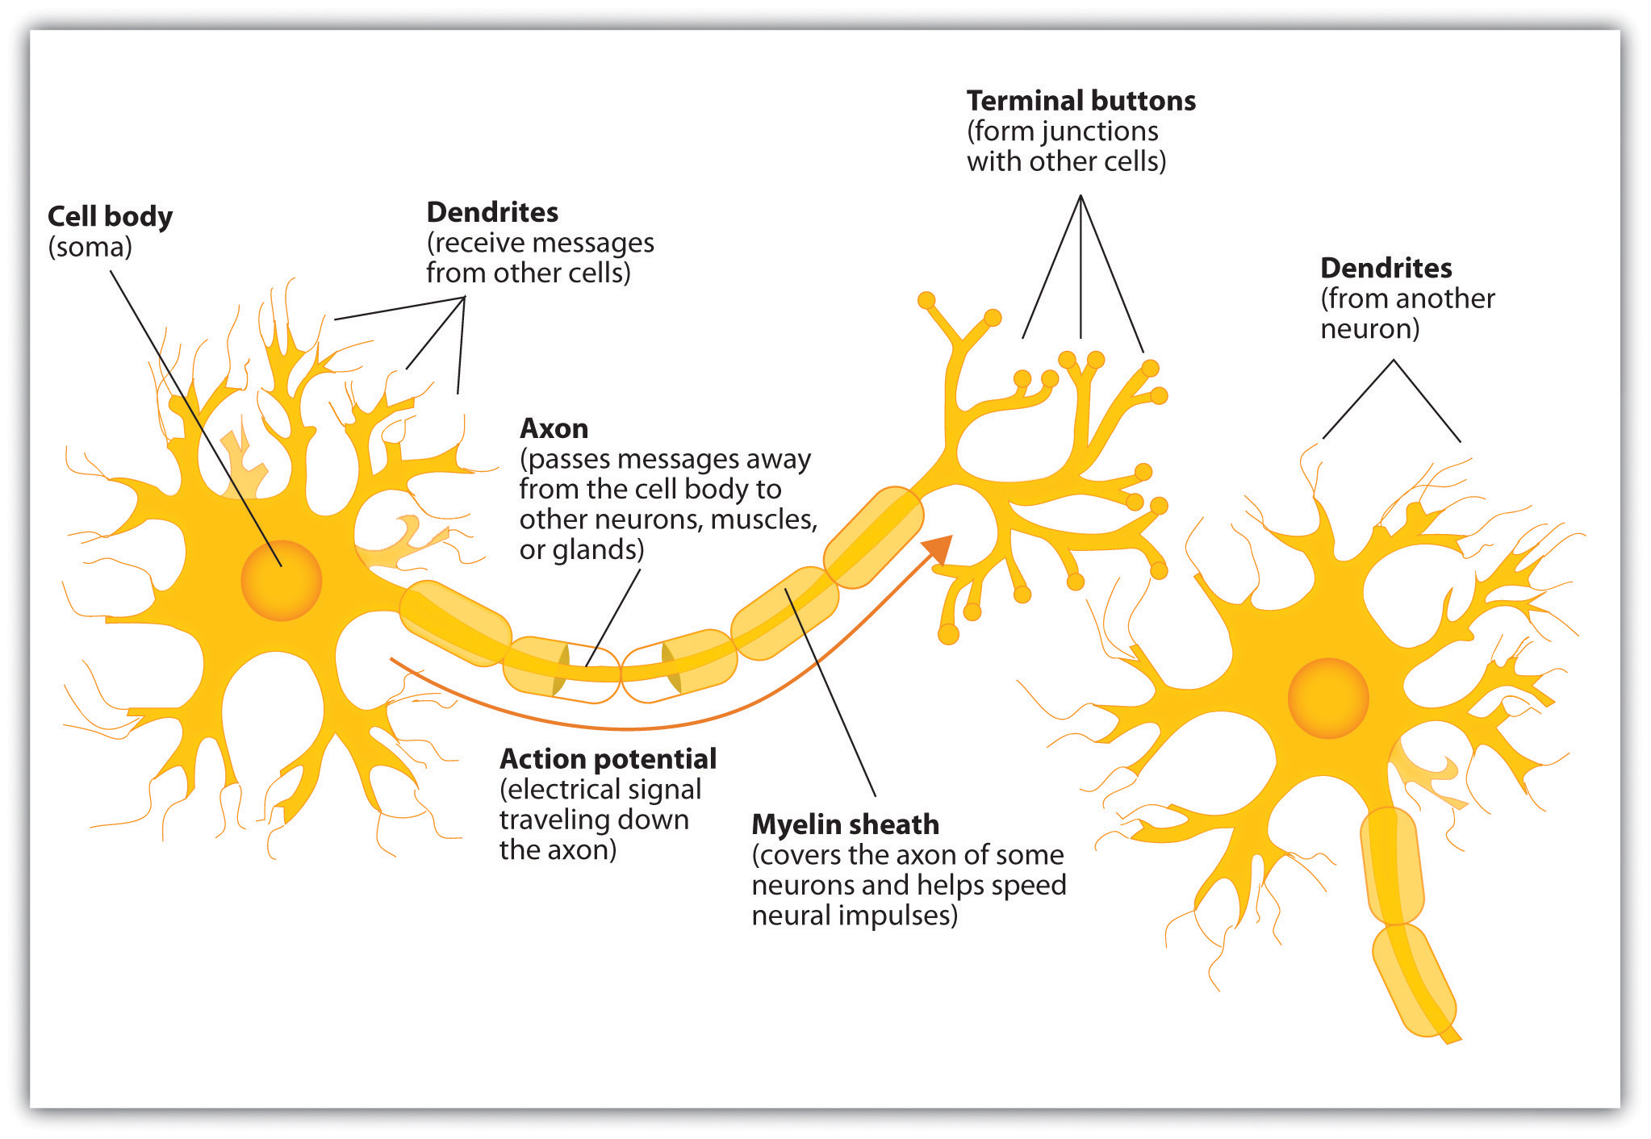
Neuron
/ Synapse

Slide 19
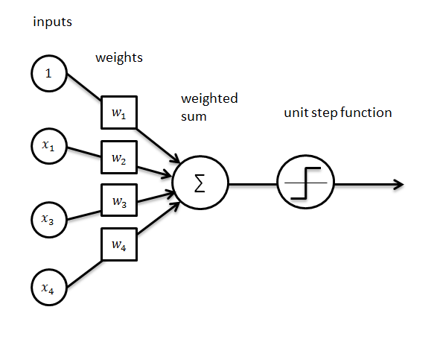
Perceptron

Slide 20
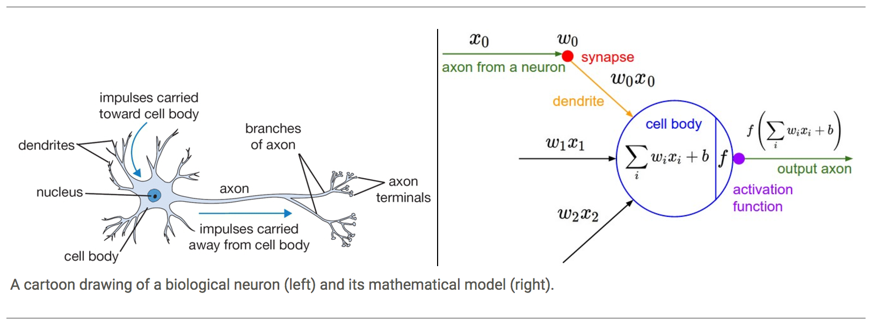
Neuron vs Perceptron

Slide 21


Slide 22


Slide 23
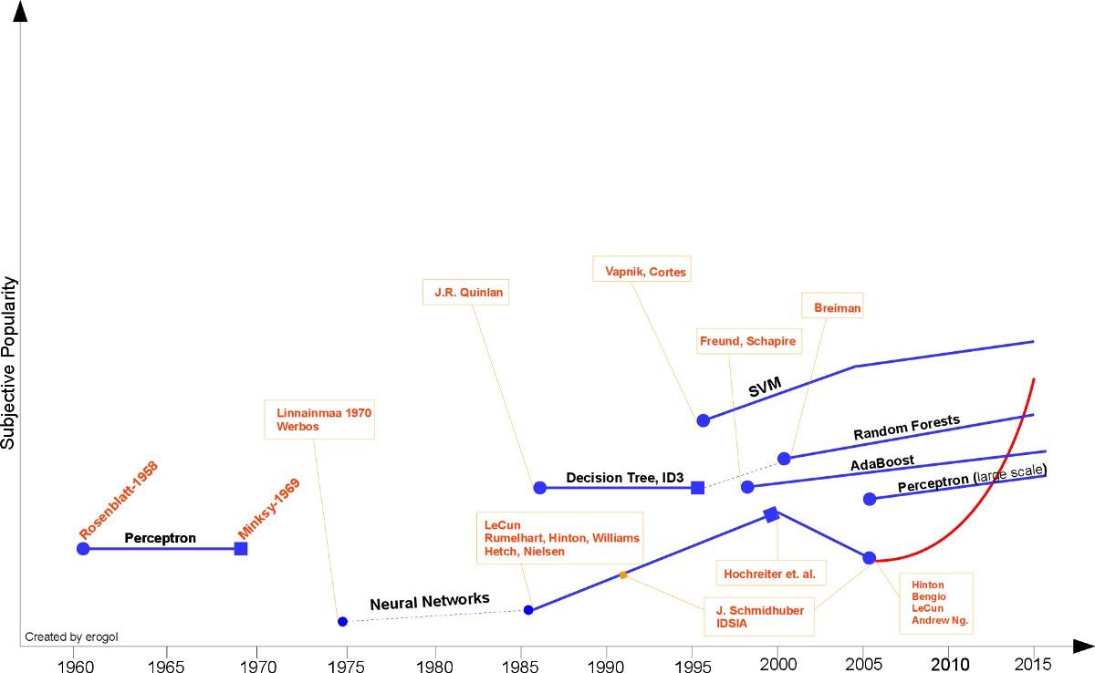

Slide 24


Slide 25
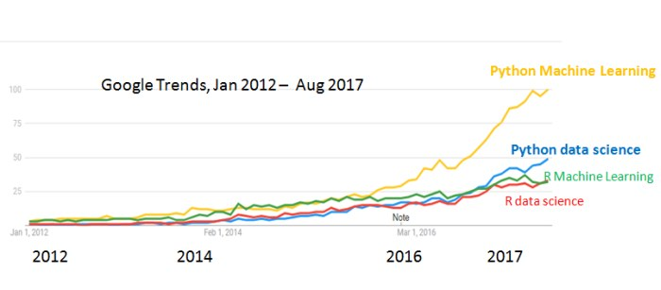

Slide 26
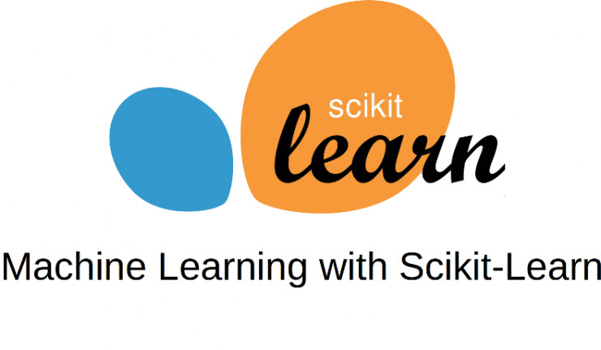

Slide 27
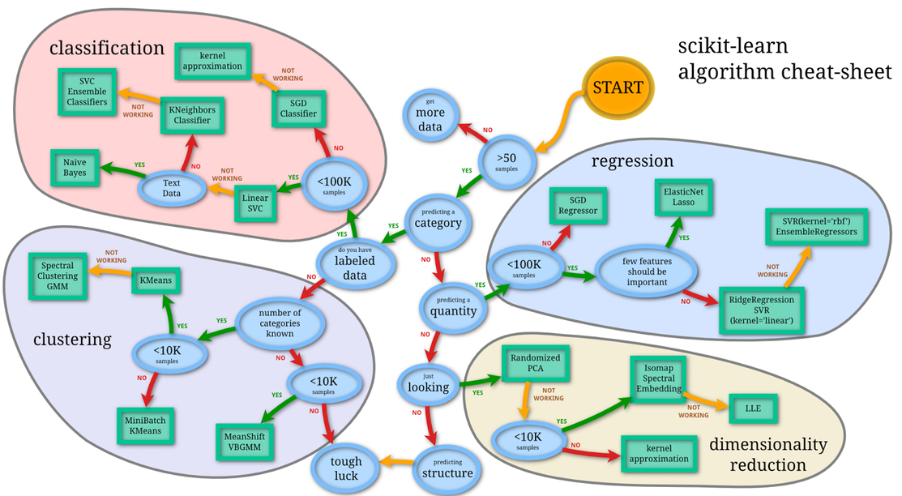

Slide 28
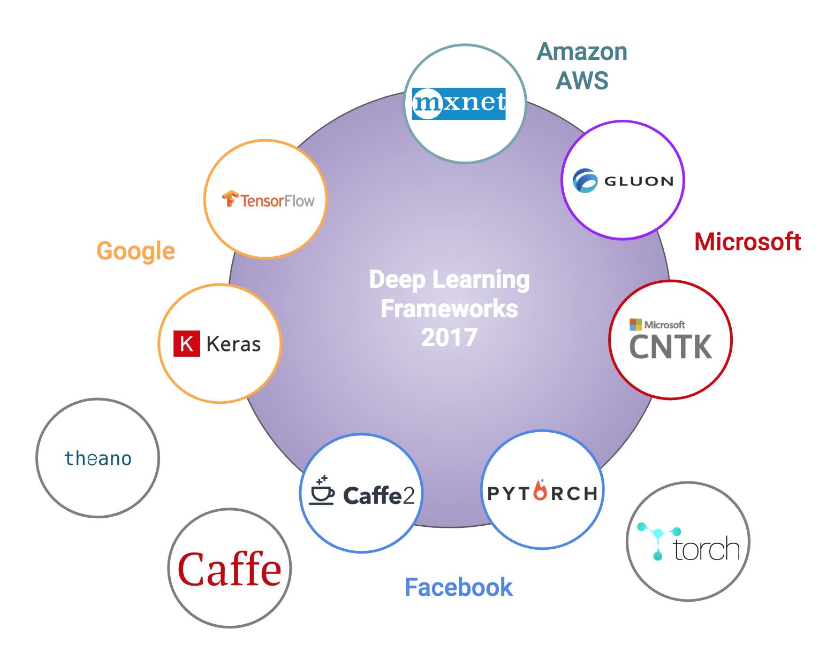

Slide 29
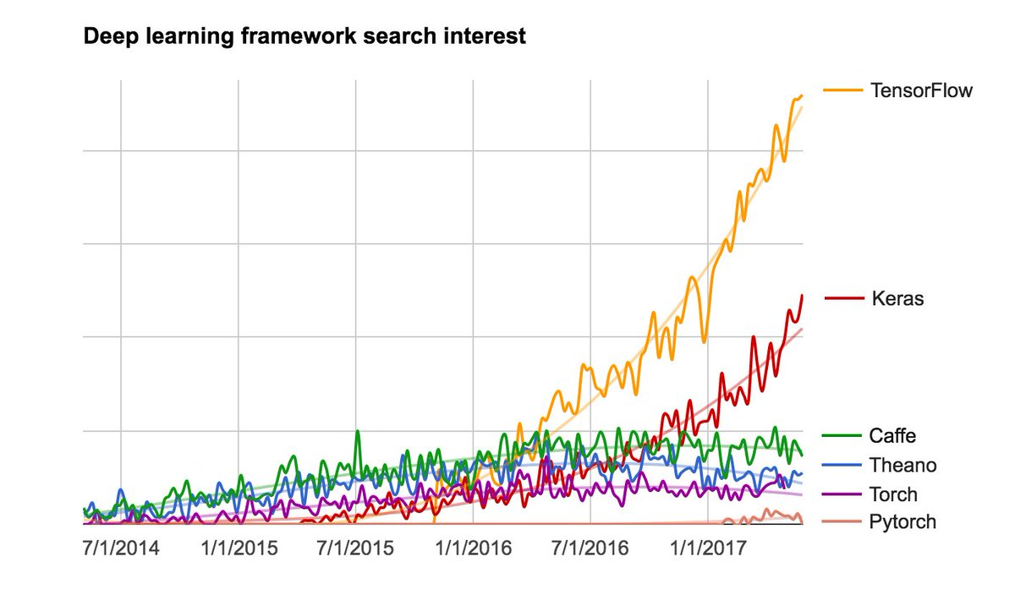

Slide 30
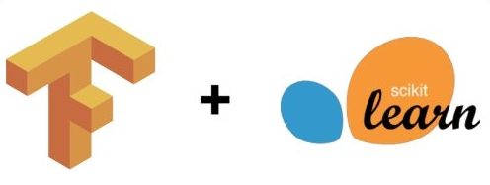

Slide 31
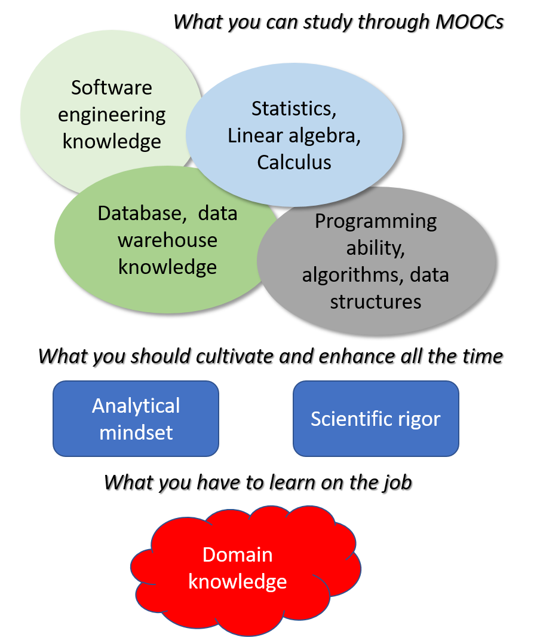

Slide 32
AI Experiments
Math Books
https://experiments.withgoogle.com/ai
Calculus Made Easy - Silvanus P. Thompson
Coding the Matrix - Philip N. Klein
Elements of Statistical Learning - Trevor Hastie and Rob Tibshirani

Slide 33
Best courses :
Machine Learning - Andrew Ng, Stanford University
Machine Learning for Undergraduates - Nando de Freitas, University of British Columbia
Machine Learning - Tom Mitchell, CMU
Learning from Data - Abu Mostafa, EdX and Caltech

Slide 34
DTeam Ai Deep Learning Course
Skills You Will Gain In This Course
Python
Tensorflow
Math behind Deep Learning
Artificial Neural Networks
Convolutional Neural Networks
Hyperparameter Optimization
Recurrent Neural Networks
Long Short-Term Memory (LSTM)
Modelling a Real World AI task
Details
8 Weeks
In weekends, both Saturday and Sunday
3 Hours a day
New batch starts from Jan 2019.

Slide 35
DTeam Ai Deep Learning Course
Syllabus
Neural Networks and Deep Learning
Introduction to deep learning
Neural Networks Basics
Shallow neural networks
Deep Neural Networks
Improving Deep Neural Networks: Hyperparameter tuning, Regularization and Optimization
Practical aspects of Deep Learning
Optimization algorithms
Hyperparameter tuning, Batch Normalization and Programming Frameworks
Convolutional Neural Networks
Foundations of Convolutional Neural Networks
Deep convolutional models: case studies
Object detection
Special applications: Face recognition & Neural style transfer

Slide 36
DTeam Ai Deep Learning Course
Sequence Models
Recurrent Neural Networks
Natural Language Processing & Word Embeddings
Sequence models & Attention mechanism
Structuring Machine Learning Projects
ML strategy
Transfer Learning
Multi-task Learning

Slide 37
Data Science Opportunities
https://economictimes.indiatimes.com/jobs/50000-data-science-ai-jobs-vacant-due-to-shortage-of-talent-report/articleshow/66230457.cms

Slide 38




Website https://academyforai.in
Academy for Ai
https://www.youtube.com/channel/UC-CFsLoMo8WeoCWGzysC1MQ
https://www.facebook.com/academyforai
https://twitter.com/academyforai
https://www.meetup.com/academyforai

